Slide 1
Benefits Claims Decision Support System Date: 1/19/16 PM: Elizabeth Wollin
Schedule | Staffing | Funding | Integration | Stakeholder Comms | VBA Overall | OI&T Overall
 | ● | ● | N/A | ● | ● | ●
Cross Dependencies: N/A
Completed this Week:
Meetings/working sessions re: methodology and calculations for compiling Ear Model Training Data
Meetings/working sessions re: schedule impacts (revised master schedule and craft memo)
Briefing w/Patrick Littlefield re: project status, modeling challenges, and proposed path forward for Ear model reconstruction
Meeting w/Elizabeth on detailed model development methodology Review of Sandbox Data
Overdue:
None
Due Next Week:
Further discussions and verification of Ear Model Training Data sample once compiled
Review preliminary design diagrams in preparation for Team working sessions the week of 1/26-28
Development of working session agenda and logistics
Analyzing DB sandbox tables.
Comparison of data with notebook explanations.
Analyzing DB sandbox tables.
Comparison of data with notebooks.
Acquisition Package and CR Updates:

Slide 2
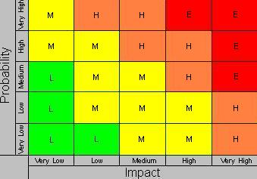
Benefits Claims Decision Support System Date: 12/11/15 PM: Elizabeth Wollin
Risk 1:
Title:
Risk: If delays in obtaining data.
Impact: The deliverables will be delayed.
Mitigation Steps to Date:
Regularly communicate timeline and data needs with VA PM.
Action Items:
VA PM working to obtain required agreements for data and data transfer.
Who: VA PM Due Date: Ongoing
Risk 2:
Title: Technical [12/11/15]
Risk: If expectations re: Mitre Scripts and Analysis duplication.
Impact: VA Stakeholder buy-in may not be obtained.
Mitigation Steps to Date:
Clearly Communication project approach and potential benefits with Business and Technical subject matter experts (SMEs).
Action Items:
Coordinates project meetings with Business and Technical SMEs.
Who: VA PM and Project Team Due Date: Ongoing
1
2

